Slide 1
Azure SQL Database, SQL Managed Instance and Azure Hybrid Benefit for SQL Server

Slide 2
Microsoft Data Platform
Most consistent experience
across on-premises and cloud
Consistent data platform for powerful hybrid scenarios
Notes:
Microsoft is the consistent Data Platform for Powerful Hybrid Scenarios such as… <click>

Slide 3
Consistent data platform across on-premises and cloud Least vulnerable across all environments
PaaS
SQL
Azure SQL Database
(SQL Server++)
Azure SQL Data Warehouse
Develop once and deploy anywhere
Common tools for development and management
Common T-SQL surface area
Simple cloud migration
Single vendor for support
IaaS
SQL Server in Azure VM
SQL Server (DW)
in Azure VM
On-premises
SQL
SQL Server
SQL Server (DW)
Reference Architecture
Most consistent data platform
Notes:
All these scenarios are made possible because of our Consistent Data Platform across on-premises and cloud
Only Microsoft can deliver customers a consistent experience from on-premises to cloud – that’s our goal.
We want ensure we deliver a great experience from on-premises to cloud. The point is you decide what is best for a particular application or workloads and you will be able to deliver it without having to rewrite your application, or learn new development tools or new development language or new management tools.
Only Microsoft can offer this consistent experience across identity, virtualization, management, and dev-ops. We’ve got all the tools that you love and we can ensure that we deliver a great experience no matter where you choose to deploy.

Slide 4
Azure SQL Database Put your database on Autopilot; focus on your business
Intelligent DBaaS
Privacy and Trust
Seamless and compatible
Competitive TCO
Notes:
Azure SQL Database has built-in intelligence that helps you dramatically reduce the costs of running and managing databases and maximizes both the performance and security of your application.
Each database is isolated from each other and portable, each with its own service tier with a guaranteed performance level. SQL Database provides different performance levels for different needs, and enables databases to be pooled to maximize the use of resources and save money. You can adjust performance without downtime to your app or to your customers. Dynamic scalability enables your database to transparently respond to rapidly changing resource requirements and enables you to only pay for the resources that you need when you need them. In-memory technologies provide real-time business insight based on operational data.
New to SQL Database is the ability to seamlessly lift and shift your SQL Server data to the cloud to a managed instance with a full SQL Server programming surface area that removes the need to re-architect your apps.
SQL Database combines the operational and financial benefits of Azure PaaS with the financially-backed SLA and business continuity tools to protect the lifeblood of your business, your data. SQL Database now offers a Azure Hybrid Benefit for SQL Server that maximizes the investments you’ve made in on-premises licensing by providing discounted rates in the cloud.

Slide 5
(2016) Azure SQL Database
Intelligent DBaaS
Privacy and Trust
Seamless and compatible
Competitive TCO
Operational analytics Columnstore Hekaton (in-memory OLTP)
Predictable performance Query Store Index Optimization
Activity monitoring Engine Audit
Access Control SQL Firewall RLS, Dynamic data masking
Data Protection Encrypt in motion (TLS) TDE Always Encrypted (equality)
HA-DR built-in 99.99% SLA Geo-restore
Backup and restore Backup with health check 35 days PITR
Distributed application Change Tracking
Biz model & SKUs DTU/eDTU <=1TB (premium & standard)

Slide 6
TCO optimization - The MS IT Example
1
DB Assessment
2
Migration
40,000 databases, across
15,000 SQL Server instances
GOAL: Reduce costs and demands on IT
SQL Server
in a VM
SQL Server
Azure SQL
Database
Schema check
Reduce CAPEX + OPEX
Compatibility check
More migrations to SQL Database over time
53%
SQL Database
potentially ready
to be migrated

Slide 7
Automatic Tuning Benefits
4592 Azure SQL Databases
Automatic Index Management
Improved over 1K queries
20.4 hours of CPU less every day
Reduced daily amount of logical reads by about 31 billion
Automated Plan Correction
Best plan forcing saved 35 hours per day in total 0.5 seconds per query execution
Best per query execution savings achieved by automatic plan forcing was 536 seconds
Total estimated daily savings are estimated at about 160 CPU hours per day
Azure SQL Database
Remove IT burden
Managed, HA built-in
Manage 1000s as one

Slide 8
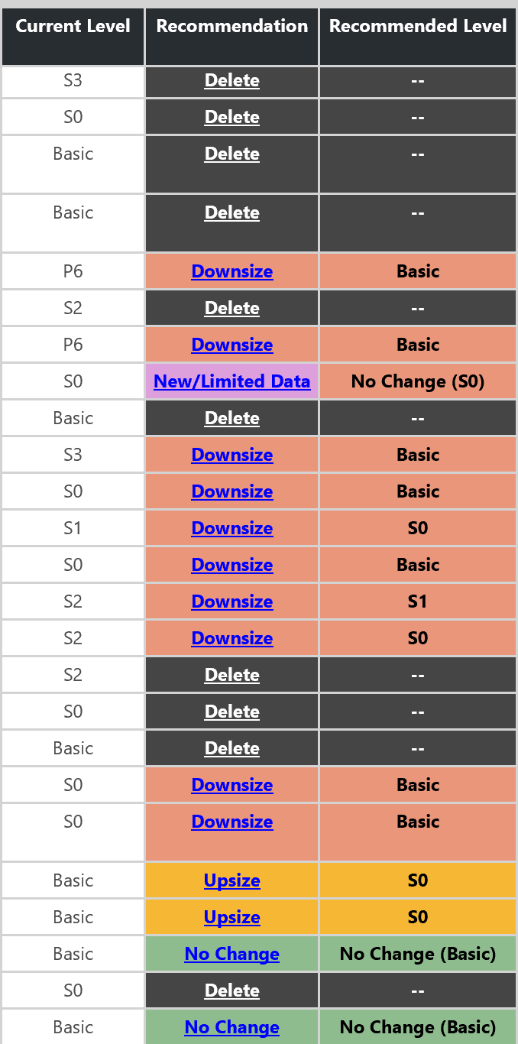
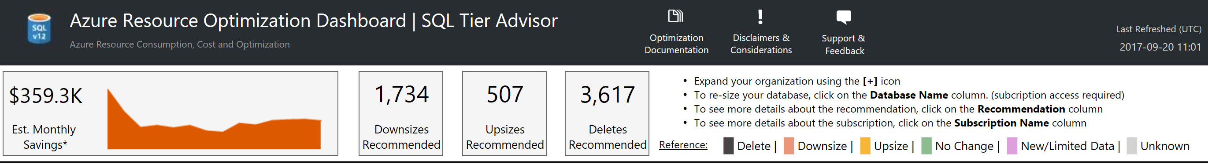
Optimizing Cost Automatically
Activity | Actual 16 months
Downsize | 4,047
Deletes | 13,816
Savings | $3,721,700
Reported incidents | 2
Service Tier Advisor provided insights to both receive recommendations and a dashboard into application workload behaviors

Slide 9
(2017) Azure SQL Database
Intelligent DBaaS
Privacy and Trust
Seamless and compatible
Competitive TCO
Operational analytics Columnstore Hekaton (in-memory OLTP)
Predictable performance Query Store Index Optimization Automatic tuning Auto query plan correction Performance Insight in OMS Adaptive Query Processing SQL Graph Advanced analytics Native PREDICT R Services
Activity monitoring Engine Audit Threat Detection Centralized dashboard OMS
Access Control SQL Firewall RLS, Dynamic data masking AAD and MFA
Data Protection Encrypt in motion (TLS) Always Encrypted (equality) TDE & BYK Service endpoint Always Encrypted (secure enclave) Discovery & Assessment Vulnerability assessment
HA-DR built-in 99.99% SLA Geo-restore Active Geo replicas (4) Multi-AZ
Backup and restore Backup with health check 35 days PITR 10 years data retention
Distributed application Change Tracking Transaction replication Data sync SSIS service Managed Instance Data Migration Service
Biz model & SKUs DTU/eDTU <=1TB Bigger std: S4-S12 Separate compute and storage Azure hybrid benefit Cost optimization Intelligent PaaS
Managed Instance

Slide 10
What is Managed Instance?

Slide 11


Why Azure SQL Managed Instance?
Are your customers interested in moving to cloud?
Want to close your data center
Current hosting solution is high maintenance
You’re asked to do more with less
Want to expand your reach globally
Managed Instance brings PaaS closer to you!
???
Do your customer want to avoid app rewrites but still benefit from PaaS?
Notes:
Are you interested in moving to cloud?
Want to close your data center
Current hosting solution is high maintenance
You’re asked to do more with less
Want to expand your reach globally

Slide 12
What is SQL Database Managed Instance?
DBaaS designed to for all SQL Server applications
SQL Database (PaaS)
Singleton
Elastic Pool
Managed Instance
Unmatched app compatibility
Unmatched PaaS capabilities
Favorable business model
Fully-fledged SQL instance with nearly 100% compat with on-prem
Lowest TCO + rich Azure ecosystem
Built-in automatic management
Compliance certifications
Competitive
Transparent
Core and storage
Frictionless

Slide 13
What can PaaS do for you?

Slide 14
How does PaaS help you?
On-prem database management tasks | How PaaS helps?
Data protection Backups (with health checks and retention) | Built-in
High availability / disaster recovery implementation Always On Database Mirroring Log shipping | Built-in
Compliance with standards | Built-in
Security Data access Defense in depth Breach detection | Easy to use tools
Monitoring | Easy to use tools
Performance tuning and maintenance Query plan regressions – detection and prevention Index optimization and maintenance | Built-in

Slide 15
Managed Instance: Unmatched PaaS capabilities
On-demand resources & elasticity
No need to provision for that monthly / yearly peak
Built-in high availability
99.99% SLA with automatic failover
Business continuity
Automatic backups, point-in-time restore, long term retention
Backups kept in geo-redundant storage
Active geo-replication (<5 sec RPO)
Automatic patching / version updates
The service guarantees availability and no regression in experience
Built-in intelligence
Threat Detection
Automatic performance tuning & Intelligent Insights

Slide 16
How to choose between PaaS and IaaS?
If you:
Need control over / access to the operating system
Have to run your app or agents side-by-side with the database
Want to continue to manage all aspects of your solution
…then IaaS is the right solution for you
Otherwise, we recommend PaaS
Much better total cost of ownership
You can focus on your business, and innovate

Slide 17
Can you get to PaaS easily?

Slide 18
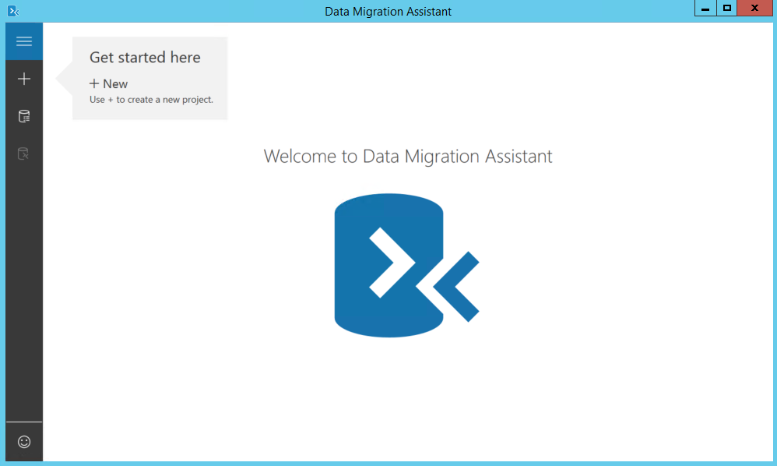
Some apps don’t need Managed Instance
You can migrate some apps w/o any changes, today
Starting migration now by
Downloading and running Data Migration Assistant (DMA)
Automated assessment will identify databases that are safe to move, w/o changes

Slide 19
Managed Instance: destination for even the most demanding applications
Offers full security & isolation
VNET enables full isolation, without public IP addresses
VPN can make it part of your enterprise network
Decreases cost and risk of migration
Instance design increases compatibility with on-premise SQL Server
Database Migration Service further simplifies and automates migration
Offers new business model and pricing
Ability to use on-premise sql server licenses

Slide 20
Full security & isolation
VNet1
VNet-to-VNet
Web app
(public IP)
SQL Instance #1
SQL Instance #2
Network isolation (customer VNET)
SQL Instance #3
Tenant isolation
(compute, storage)
“Virtual data cluster” dedicated to customer
(virtual private cluster, VNET, private IPs)
VPN / Express Route Gateway
IPsec IKE S2S VPN Tunnel
оn-premises

Slide 21


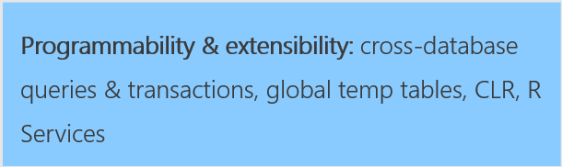
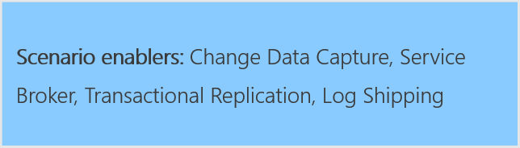
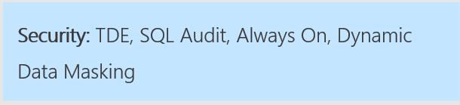

Nearly 100% compatibility with SQL server
Support is coming in stages until General Availability of Managed Instance

Slide 22
Migration: Version compatibility
Most users would prefer the latest version
The major concern is risk associated to upgrades
We will support migrations from SQL 2005+
We will keep supporting old version DB compatility levels in cloud
10% doesn’t care
9% must run the same version
81% would prefer the latest version

Slide 23
Azure Database Migration Service (DMS)
Reliable and seamless migrations
Fully managed database migration service for both operational databases and data warehouses
Supports minimal down time migrations
Supports both homogeneous and heterogeneous source-target pairs
Initial focus on reliability and performance
Iterative addition of source-target pairs
Continued investment in friction-free competitive conversions
SQL DB
Oracle
SQL
SQL

Slide 24
Migration: SSIS / SSAS / SSRS
These services will not be installed side-by-side with Managed Instance
Recommendation: move to PaaS model
Migrate your SSIS packages to new SSIS PaaS service
Migrate your OLAP models to Azure Analysis Services
… or run these services in Azure virtual machines
For SSRS, the recommendation is to run in a virtual machine
Notes:
The PaaS model for these services has many advantages: provisioning on demand, scale-up and down, start/pause, etc. Also, it opens up opportunities with connecting to other Azure services easily, and enriching your data integration, BI or reporting workflows… opens up the way to modernization.
VMs are the fallback option… and for SSRS this is currently the only option. There is a licensing aspect here as well, as to run SSIS / SSAS or SSRS in a VM, you need a SQL Server license. In PaaS services, you pay exactly what you’re using, so you should have more cost control this way.

Slide 25
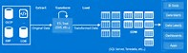
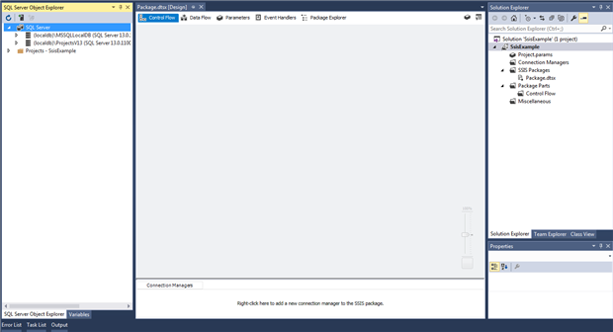
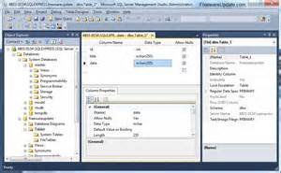
SSIS PaaS service (in preview)
Goal: execute your SSIS packages, without changes
How?
SSIS instance provisioned under Azure Data Factory
Catalog (SSISDB) can be stored on Managed Instance
Authoring / deployment by SSDT
Execution / management by SSMS and SQL Agent
Provisioned on-demand, tunable scale
ADF (ENTRY POINT, ORCHESTRATION, DESIGN)
Provision
SSIS PaaS on ADF compute resource
Execute/ Manage
Author/
Deploy
Cloud
On-Premises
Author/Deploy
Execute/Manage
SSDT (ENTRY POINT)
SSMS (ENTRY POINT)
Author/Deploy
SSIS Server
Execute/Manage

Slide 26
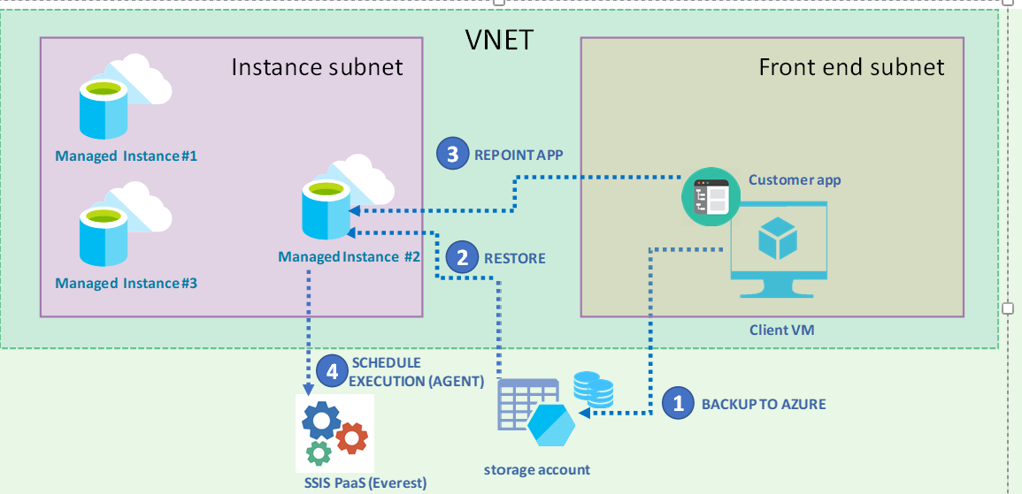
Demo: Migrate Easily to Managed Instance

Slide 27

DATA CDN for your Edge Geo-Replication to edges of your deployments
GA
Automatic failover policy
Replicas are automatically points to the new primary afterward
Replicas to fit your topology
Same region or different region
Available in all 38 Azure regions!
REST API, PowerShell or Azure Portal
Up to 4 secondaries

Slide 28
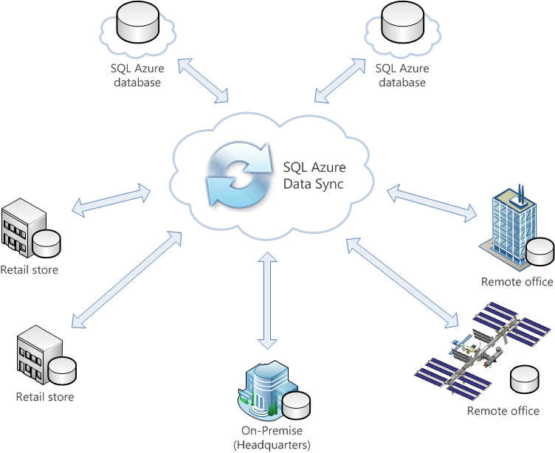
Keep data up-to-date across all SQL databases Distributed Applications
SQL Azure Data Sync (v2)
Public Preview
All SQL databases supported (SQL Server, SQL IaaS & Azure SQL Database)
Zero code required to enable data synchronization among SQL databases
Hub-and-Spoke Synchronization technology
Both One-way or Bi-directional synchronization
Table-level synchronization with Column Filter
Minute-level latency
Notes:
SQL Data Sync allows developers to easily synchronize reference data across multiple SQL Server, SQL VM, and Azure SQL databases. Increasing number of developers and ISVs are developing and running their geo-distributed SaaS and hybrid applications on Azure and utilizing Azure SQL Database as the data-tier. For on-prem SQL Servers with intermittent connectivity to the cloud or for Azure applications that desire low latency, a copy of the reference data needs to be co-located with the application for optimal lookup and update speeds.
With the ability to sync one-way or bi-directionally, SQL Data Sync enables developers to set up scheduled synchronization without having to write any custom code or managing their own cloud infrastructure. Besides going through Microsoft Azure Portal, users can also use Powershell and REST APIs to get diagnostic logs and alerting.

Slide 29
Seamless cloud integration Easy lift-and-shift, integrate and distribute
Azure SQL Database Managed Instance
Managed SSIS in Azure
Azure SQL Database Managed Instance facilitates lift and shift migration from on-premises SQL Server to cloud
Azure Hybrid Benefit for SQL Server maximizes current on-premises license investments to facilitate migration
Database Migration Service (DMS) provides seamless and reliable migration at scale with minimal downtime
Active Geo-replicas “data CDN” for your edge deployments
SQL Azure Data Sync v2 synchronize data across distributed and occasionally connected applications
Azure Hybrid Benefit (AHB) for SQL Server
Database Migration Service (DMS)
SQL Server
Most consistent data platform

Slide 30
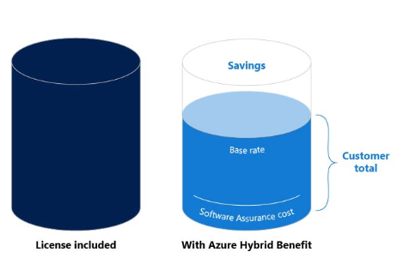
Hybrid Use Benefit for SQL Server
Maximize your current Software Assurance investment by using your existing SQL Server licenses to save up to 30 percent on vCore-based SQL Database options.

Slide 31
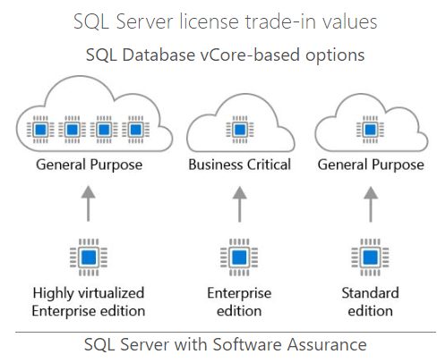
Get more for your virtualized workloads
SQL Server EE Customers with SA can move to SQL Database at a cost effective rate
Azure HUB for SQL Server provides SQL Server EE Customers with 4 cores in cloud for every 1 core on-prem
Source: Azure Hybrid Benefit Savings calculator

Slide 32
Example
On-prem Core Licenses | Instances in Azure
1 Standard Edition | 1 General purpose Instance
1 Enterprise Edition | 4 General Purpose Instances
Approximate savings of 33.6% across eligible instances per month.
Source: Azure Hybrid Benefit Savings calculator

